Slide 1
MACHINE FAILURE Prediction
4th March 2025
Dhanumitha Vijayakumar
Data Science, January 2025 Batch

Slide 2
AGENDA
01
INTRODUCTION
04
ALGORITHMS
Objective
Goals
Overview
Logistic Regression
Random Forest Classifier
Gradient Boosting Classifier
Support Vector Machine (SVM)
02
PARAMETERS
05
CLOSING
Features
Dependency
Conclusion
Insights
Thank You
03
DATA ANALYSIS
Basic Information
Summary Statistics
Project Analysis

Slide 3
01
Introduction

Slide 4
OVERVIEW
Machine failures can lead to operational downtime, increased maintenance costs, and reduced efficiency. This report analyzes machine sensor data to predict future failures, allowing for preventive maintenance and optimized performance.

Slide 5
OBJECTIVE
The primary goal of this project is to build a predictive model that can assess the likelihood of a machine failure based on real-time sensor data.The objectives include:
● Analyzing historical sensor data to identify key indicators of machine failure.
● Training machine learning models for failure prediction.
● Evaluating model performance using standard metrics.
● Deploying the best model for real-time monitoring.

Slide 6
GOALS
The main goal of this project is to analyze the following aspects:
1. Explore the data (summary statistics, missing values, correlations)
2. Visualize the data (plots, distributions)
3. Train a machine learning model to predict failure.
80
70
60
50
40
30
20
10
BAR GRAPH INFO 1
BAR GRAPH INFO 1
BAR GRAPH INFO 1
BAR GRAPH INFO 1

Slide 7
02
PARAMETERS

Slide 8
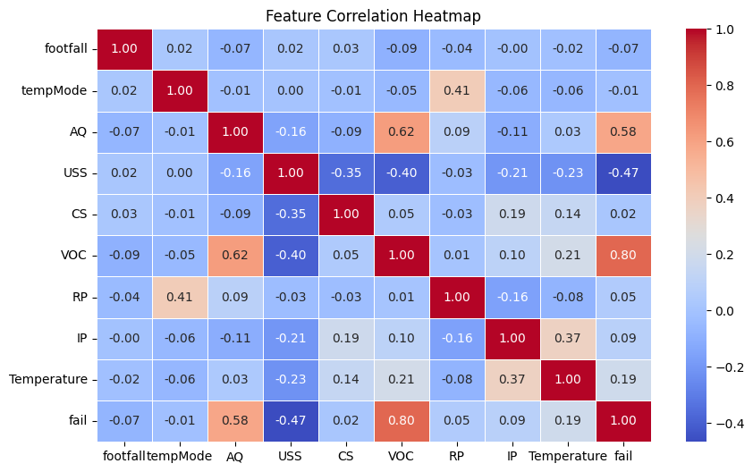
PARAMETERS INFLUENCING THE MACHINE FAILURE
VOC-41.8596%
AQ-20.3282%
USS-11.9737%
CS-5.9648%
RP-5.0531%
footfal- 4.9972%
Temperature-4.5628%
IP-2.6764%
tempMode-2.5840%

Slide 9
DESCRIPTION
PARAMETERS INFLUENCING THE MACHINE FAILURE
footfall
AQ
Air quality index near the machine
The number of people or objects passing by the machine.
USS
Temp Mode
Ultrasonic sensor data, indicating proximity measurements
CS
The temperature mode or setting of the machine.
Current sensor readings, indicating the electrical current usage of the machine
VOC
IP
Volatile organic compounds level detected near the machine.
Input pressure to the machine.
Temperature
RP
Rotational position or RPM (revolutions per minute) of the machine parts
The operating temperature of the machine.

Slide 10
03
Data Analysis

Slide 11
BASIC INFORMATION
● Number of rows-944
● Number of columns-10
● All columns are of integer type (int64)
● No missing values in any column

Slide 12
SUMMARY STATISTICS
● footfall: Ranges from 0 to 7300, with a high standard deviation (1082.61), indicating variability.
● tempMode: Has values between 0 and 7.
● AQ (Air Quality Index): Values range from 1 to 7.
● USS (Ultrasonic Sensor): Values between 1 and 7.
● CS (Current Sensor): Values between 1 and 7.
● VOC (Volatile Organic Compounds): Ranges from 0 to 6.
● RP (Rotational Position/RPM): Between 19 and 91.
● IP (Input Pressure): Between 1 and 7.
● Temperature: Between 1°C and 24°C.
● fail (Machine Failure Indicator): Binary (0 or 1), with 41.63% of records indicating failure

Slide 13
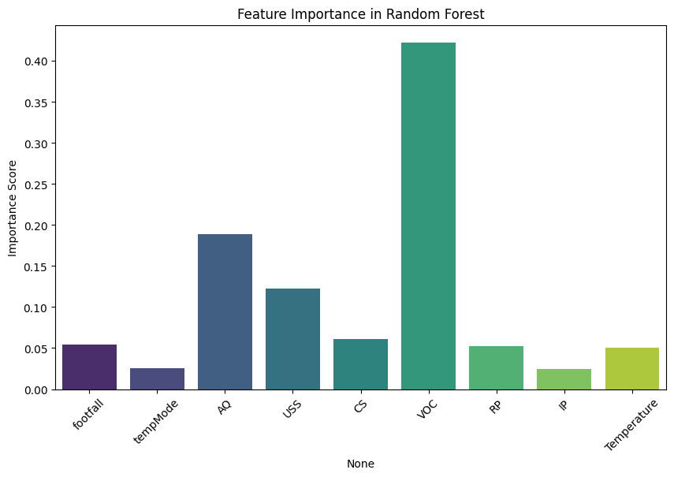
INDUSTRY VALUE CURVE
STRATEGIC MOVE

Slide 14
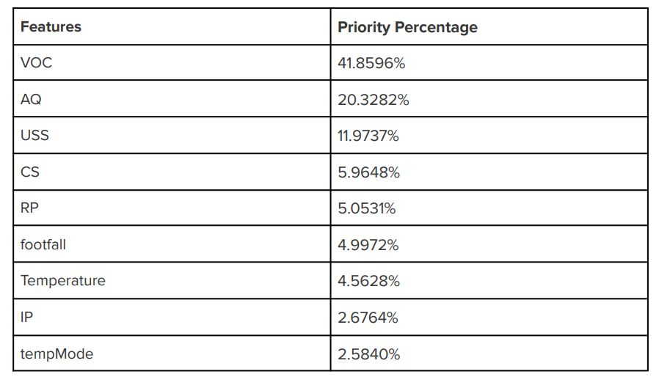
● Feature Importance Ranking
PROJECT ANALYSIS

Slide 15
● From the given dataset, it can be concluded that ‘fail’ is the dependent variable with discrete values. Since the data is numerical, it is a supervised data. It falls under the classification for discontinuous data
.
● Model Accuracy – The accuracy score tells us how well the model is predicting failures. A high accuracy (close to 1.0) means the model is performing well, while a lower accuracy suggests room for improvement.
● Precision (True Positives / (True Positives + False Positives)) tells us how many predicted failures were actually failures.
Recall (True Positives / (True Positives + False Negatives)) shows how well the model captures all actual failures.
F1-score balances precision and recall. If recall is low, the model might be missing actual failures, which is critical in maintenance scenarios.

Slide 16
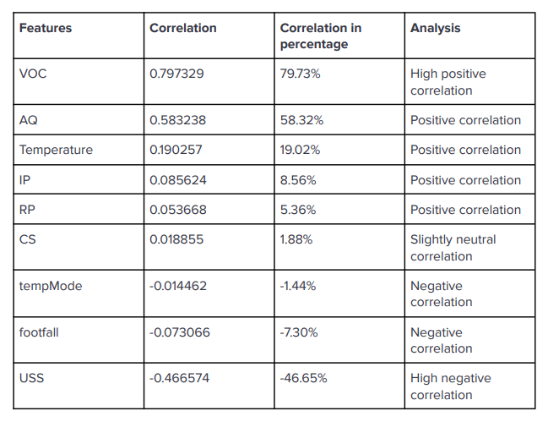
● Correlation of Features with Machine

Slide 17
● Classification Report – The precision, recall, and F1-score indicate how well the model distinguishes between failing and non-failing machines.
● The non-failure count is higher than the failure count.
● Confusion Matrix
If False Negatives (missed failures) are high, the model may not be reliable for predicting failures in advance.
If False Positives (wrongly predicted failures) are high, the model might be too sensitive, leading to unnecessary maintenance.

Slide 18
04
Algorithms

Slide 19
LOGISTIC REGRESSION
Concept: Logistic Regression is a statistical method used for binary classification problems. It estimates the probability of an event occurring (machine failure in this case) using the sigmoid function.
Why Used?
● Simple and interpretable model
● Works well with linearly separable data
● Outputs probabilities, helping in risk assessment
Limitations:
● Assumes linear decision boundary
● Performance drops with highly complex data

Slide 20
2. RANDOM FOREST CLASSIFIER
Concept: Random Forest is an ensemble learning method that constructs multiple decision trees and combines their predictions. Each tree is trained on a random subset of the dataset (bagging technique). The final prediction is made based on the majority vote from all trees.
Why Used?
● Handles non-linear relationships well
● Reduces overfitting due to ensemble averaging
● Provides feature importance scores
Limitations:
● Computationally expensive
● Difficult to interpret compared to simpler models

Slide 21
3. GRADIENT BOOSTING CLASSIFIER
Concept:
Gradient Boosting is another ensemble learning method that builds trees sequentially. Unlike Random Forest, where trees are trained independently, Gradient Boosting trains each tree to correct errors made by the previous ones. This is done by minimizing a loss function through gradient descent.
Why Used?
● Highly accurate for structured datasets
● Handles complex relationships in data
● Works well with small to medium-sized datasets
Limitations:
● Training can be slow
● Prone to overfitting if not carefully tuned

Slide 22
4. SUPPORT VECTOR MACHINE (SVM)
Concept:
SVM is a powerful classifier that finds the optimal hyperplane that best separates data points of different classes. It uses kernel functions to transform data into higher dimensions when needed.
Why Used?
● Effective for high-dimensional spaces
● Works well when data is not linearly separable
● Can handle noisy data with soft margin techniques
Limitations:
● Slower training time for large datasets
● Choosing the right kernel is crucial

Slide 23
05
Closing

Slide 24
CONCLUSION AND INSIGHTS
● The Gradient Boosting Classifier emerged as the most effective model with 92% accuracy.
● Feature importance analysis highlighted CS (Current Sensor), Temperature, and VOC as the strongest predictors of failure.
● The developed model can be used to monitor real-time data and predict machine failures, allowing industries to take proactive maintenance measures. The machine failure prediction model will classify whether a machine passes (does not fail) or fails based on the given sensor data.

Slide 25
How is the decision made?
1. The trained Gradient Boosting Classifier (92% accuracy) or another chosen model will take new sensor readings as input.
2. The model will output 1 (Fail) or 0 (Pass/No Failure) based on the learned patterns from historical data.
3. The probability of failure can also be calculated to determine how likely the machine is to fail. It can be concluded that the machine does not fail, as the model predicts its result to be 1.

Slide 26
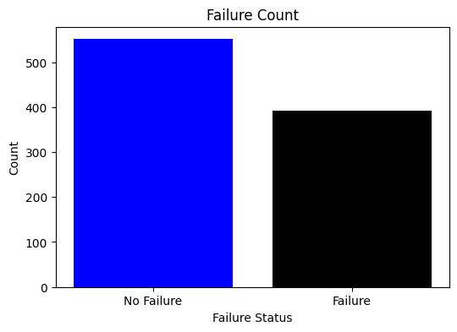
It can be concluded that the machine does not fail, as the model predicts its result to be 1.

Slide 27
THANK YOU
DHANUMITHA VIJAYAKUMAR
4th MARCH 2025

